Slide 1
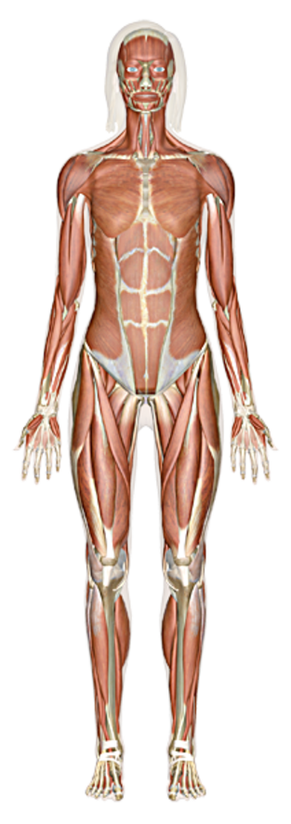
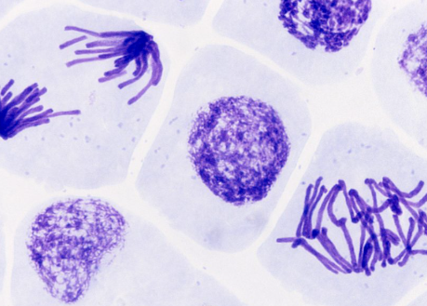
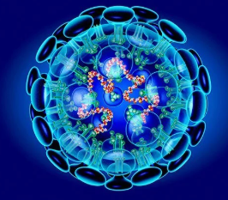
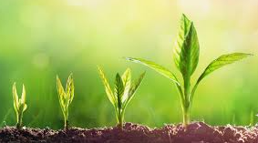
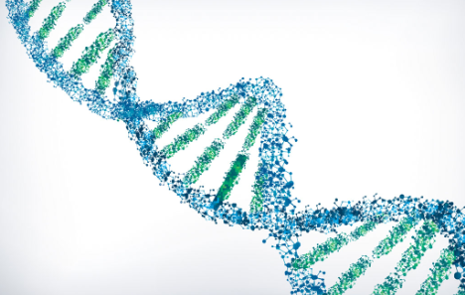
A-level Biology Taster Lesson
1. What does the course look like?
2. What can I do to prepare for September?
3. What is DNA replication?

Slide 2
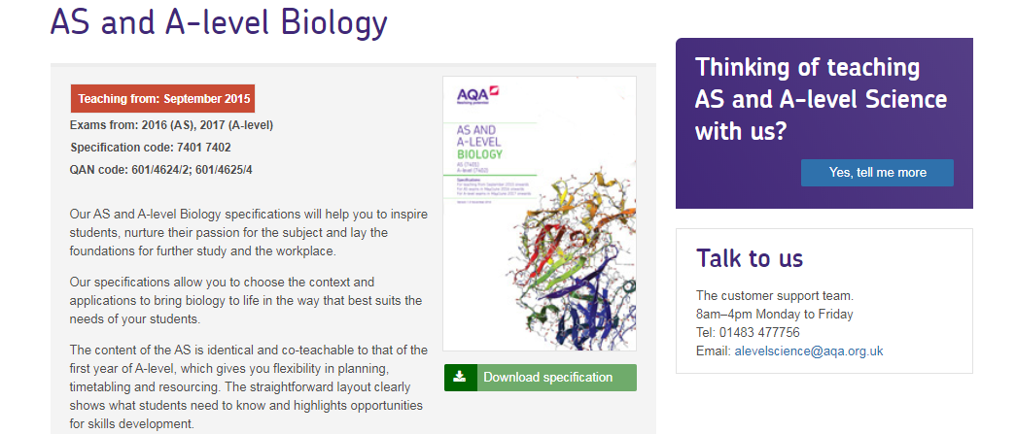
What course will I be studying?
The course is AQA Biology A-level (7402)
Please download the specification to look through from here: https://www.aqa.org.uk/subjects/science/as-and-a-level/biology-7401-7402
1. What does the course look like?
2. What can I do to prepare for September?
3. What is DNA replication?

Slide 3
What will I study in biology?
As-level content (year 12)
1. Biological molecules
2. Cells
3. Organisms exchange substances with their environment
4. Genetic information, variation and relationships between organisms
A-level content (year 13)
5. Energy transfers in and between organisms
6. Organisms respond to changes in their internal and external environments
7. Genetics, populations, evolution and ecosystems
8. The control of gene expression
1. What does the course look like?
2. What can I do to prepare for September?
3. What is DNA replication?

Slide 4
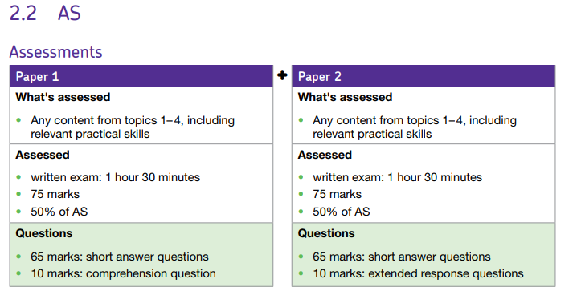
As-level exam
The As-level papers are normally in May.
There are two papers with mixed content on each paper from the first year of the course.
Each paper is worth 50% of the assessment.
1. What does the course look like?
2. What can I do to prepare for September?
3. What is DNA replication?

Slide 5
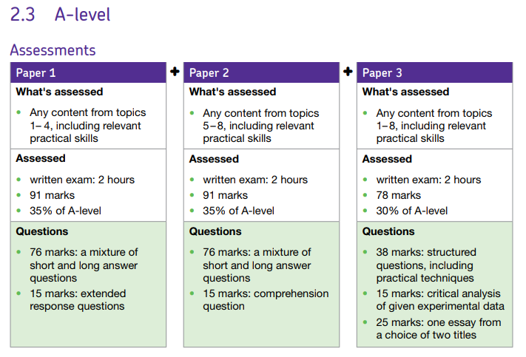
A-level exam
The A-level papers are normally in June/July.
There are three papers with yr12 content on paper 1, yr13 content on paper 2. Paper 3 combines all the topics and tends to be more practical and maths questions.
Paper 3 also has a 25 mark essay which encompasses a common theme from the entire course. Eg. The importance of water
1. What does the course look like?
2. What can I do to prepare for September?
3. What is DNA replication?

Slide 6
How can I prepare for September?
Buy a lever-arch folder and dividers – you will need to bring this to your first biology lesson (and every lesson after that!)
Print the specification from the AQA website if you can and put this in your folder
Complete the GCSE biology recall questions – most of you have emailed me for these already from your bridging tasks
Read some of the biological review articles (attached) – these will help to apply your knowledge
Be prepared for a GCSE style science exam the week you start in September
1. What does the course look like?
2. What can I do to prepare for September?
3. What is DNA replication?

Slide 7
Lets make a start!
What is DNA replication?
This is part of topic 4 of the course and relies on your knowledge of DNA, genetics and biological molecules.
TASK: Define these common biological terms
DNA
Gene
Chromosome
Genome
Complementary base pair
Degenerate DNA code
RNA
Amino acid
Nucleotide
1. What does the course look like?
2. What can I do to prepare for September?
3. What is DNA replication?

Slide 8
DNA Replication
DNA replication is important when a cell needs to clone itself during the process of mitosis
The DNA must be copied exactly to make sure both daughter cells contain the same genetic information
Mitosis is important in the body for growth, repair and to replace old cells
The genetic material copied in the process must be exactly the same so that the new cell can produce the correct proteins it needs to work effectively
Mistakes in the DNA replication process can lead to mutations and faulty proteins made by the cell
1. What does the course look like?
2. What can I do to prepare for September?
3. What is DNA replication?

Slide 9
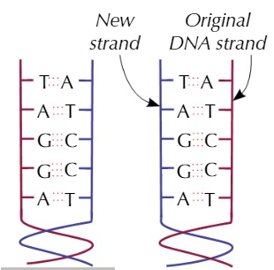
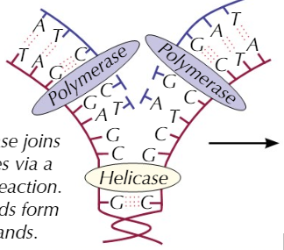
DNA Replication
1. What does the course look like?
2. What can I do to prepare for September?
3. What is DNA replication?
So how does one molecule of DNA make two?
The strands of the double helix are separated using an enzyme called helicase
This breaks the hydrogen bonds that hold together the complementary base pairs
Another enzyme (DNA polymerase) then attaches free nucleotides to the exposed base pairs
Bases only join up with complementary bases
The resulting two DNA molecules are made up of one original strand and one new one
Watch this video to find out more!
https://www.khanacademy.org/science/biology/dna-as-the-genetic-material/dna-replication/v/rna-transcription-and-translation
Or read this!
https://www.khanacademy.org/science/biology/dna-as-the-genetic-material/dna-replication/a/molecular-mechanism-of-dna-replication

Slide 10
DNA Replication Model
You are going to make a model to represent DNA replication.
You will need:
straws of two different colours, cut into 3 cm sections (84 of 1 colour, 21 of another)
scissors
permanent marker
5 treasury tags
post it notes (35 pink, 26 blue, 26 yellow, 24 green and 10 orange) cut into 1cm strips
100 paper clips
You may need to substitute some materials with others depending on what you can find at home!
Eg. You could use string instead of straws
1. What does the course look like?
2. What can I do to prepare for September?
3. What is DNA replication?

Slide 11
Part A: Making the DNA model
1. Put a pink post it note midway along the length of a red straw segment. Push a paperclip into the bottom end of the straw segment until the clip is half way in.
1. What does the course look like?
2. What can I do to prepare for September?
3. What is DNA replication?
2. Insert the paper clip from the pink post it note segment into the open end of a red straw segment with a green post it note midway along. Add additional straw segments to the green-segment end in the following order: blue, yellow, blue, yellow, blue, yellow, green, pink, pink, green, yellow, blue, pink, green, pink, yellow green, pink and pink. This chain of segments is one-half of your first model. This will be your 5’ to 3’ strand (the coding strand). Label the top of the first pink post it note section with 5’ and the last pink section with 3’.

Slide 12
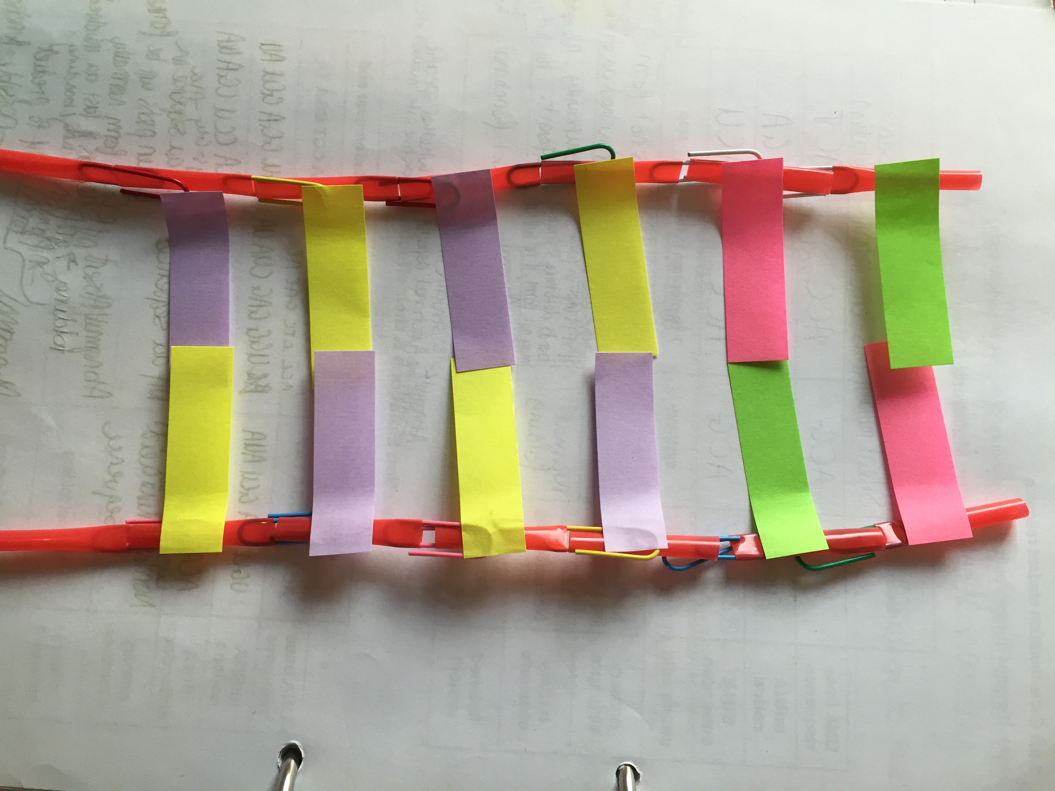
Part A: Making the DNA model
3. Assign nucleotides to the corresponding post it note colors as follows: pink: adenine, blue: guanine, yellow: cytosine, and green: thymine.
1. What does the course look like?
2. What can I do to prepare for September?
3. What is DNA replication?
4. Construct the other strand of your first model. Begin with a green segment across from the pink post it note at the top of your first model. Keep the post it notes in a straight line. Link segments together in this second strand of DNA according to the base-pairing rules.
5. When you have completed your model of one DNA segment, make a sketch of the model. Use colored pencils or pens to designate the post it note colors. Include a key that indicates which nucleotide each color represents in your sketch.

Slide 13
Part B: Modelling DNA Replication
Place the chains parallel to each other on the table. The “top” pink post it note of the first chain should face the “top” green post it note of the second chain.
Act as DNA helicase catalysing the breaking of the hydrogen bonds between base pairs and form the replication fork, where each strand acts as a template for the formation of a new strand.
Your free DNA nucleotides (3cm sections of straw with post it notes attached) have been activated by ATP and move towards their complementary base pairs
1. What does the course look like?
2. What can I do to prepare for September?
3. What is DNA replication?
One of your pair needs to act as DNA polymerase on the leading strand (3’ to 5’) by catalysing the formation of sugar-phosphate bonds (place paperclips between the straw sections), forming a new complementary strand of DNA continuously.

Slide 14
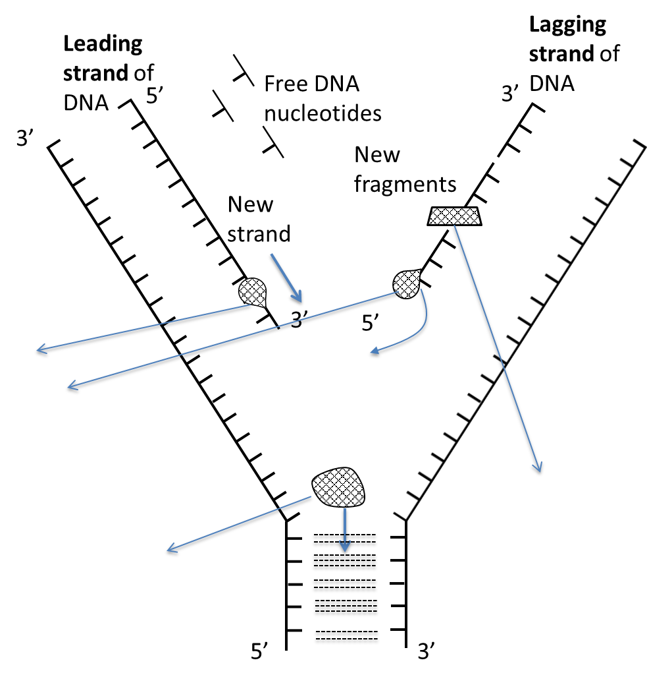
Part B: Modelling DNA Replication
One of your pair needs to act as DNA polymerase on the lagging strand (5’ to 3’), DNA polymerase creates fragments of new DNA and then act as DNA ligase joining the fragments together (place paperclips between the straw sections).
Label the process of DNA replication. Label the replication fork, the enzymes involved, the segments of original DNA, and the segments of new DNA.
1. What does the course look like?
2. What can I do to prepare for September?
3. What is DNA replication?

Slide 15
Keep in touch!
Send us a picture of your model or email us any questions you have about studying A-level biology.
Miss Peach – apeach@nationalce-ac.org.uk
Mrs Lord – tlord@Holgate-ac.org.uk
We look forward to seeing you in September!
1. What does the course look like?
2. What can I do to prepare for September?
3. What is DNA replication?

