Slide 1
Firstly this course has changed
We used to run AQA L3 Engineering Mechatronics
However due to the course now being cancelled we have had to start a new course. BTEC Level 3 National Extended Certificate in Engineering
We will introduce some of the key aspects of this course in this session
We apologise for the inconvenience and confusion but it was not announced until after the 6th form open evening.
If you have any questions please contact Mr Gregory
lgregory@nationalce-ac.org.uk
https://qualifications.pearson.com/content/dam/pdf/BTEC-Nationals/Engineering/2016/specification-and-sample-assessments/SPEC-BTEC-NAT-ENG-ExtCert.pdf

Slide 2
Key course information
This qualification provides a broad basis of study for the engineering sector. It has been designed to support progression to higher education when taken as part of a programme of study that includes other appropriate BTEC Nationals or A Levels.
Equivalent in size to one A Level.
4 units of which 3 are mandatory and 2 are external.
A link to the course specification for further reading can be found at:
https://qualifications.pearson.com/content/dam/pdf/BTEC-Nationals/Engineering/2016/specification-and-sample-assessments/SPEC-BTEC-NAT-ENG-ExtCert.pdf

Slide 3
Why this course?
Much of the reason for choosing this course is due to the similarity of both the structure and content of the course.
There are still 4 units which are taken over 2 years.
There are still practical elements
There is still an exam based around engineering maths and science.
There is still report writing
You will still be using the skills you have developed in KS4
Provides flexibility as the 4th unit can be our choice
If students drop out at the end of year 1 you still get a qualification equivalent to half an A-Level.
https://qualifications.pearson.com/content/dam/pdf/BTEC-Nationals/Engineering/2016/specification-and-sample-assessments/SPEC-BTEC-NAT-ENG-ExtCert.pdf

Slide 4
Course content
The 4 units are as follows:
Unit 1 – Engineering principles
Unit 2 - Delivery of Engineering Processes Safely as a Team
Unit 3 - Engineering Product Design and Manufacture
The 4th unit can be chosen from a possible 11 options units
https://qualifications.pearson.com/content/dam/pdf/BTEC-Nationals/Engineering/2016/specification-and-sample-assessments/SPEC-BTEC-NAT-ENG-ExtCert.pdf

Slide 5
What does this qualification cover?
Engineering covers a broad variety of roles and it involves the application of scientific principles and practical knowledge to transform ideas and materials into products and systems safely and support them during their lifetime. This qualification has a focus on a broad range of engineering specialist areas. Learners taking this qualification will study mandatory content covering:
Engineering principles and mathematics
Health and safety, team work and interpreting and creating computer-aided engineering.
Manufacturing
Drawings
Design and manufacture of products.
If you have any further questions please contact Mr Gregory
lgregory@nationalce-ac.org.uk
https://qualifications.pearson.com/content/dam/pdf/BTEC-Nationals/Engineering/2016/specification-and-sample-assessments/SPEC-BTEC-NAT-ENG-ExtCert.pdf

Slide 6
How is it assessed?
All assessment for the BTEC qualifications in this specification is criterion referenced, based on the achievement of specified learning outcomes.
Each unit within the qualification has specified assessment and grading criteria which are to be used for grading purposes.
A summative unit grade can be awarded at pass, merit or distinction:
To achieve a ‘pass’ a learner must have satisfied all the pass assessment criteria
To achieve a ‘merit’ a learner must additionally have satisfied all the merit grading criteria
To achieve a ‘distinction’ a learner must additionally have satisfied all the distinction grading criteria.
Learners who complete the unit but who do not meet all the pass criteria are graded ‘unclassified’.
https://qualifications.pearson.com/content/dam/pdf/BTEC-Nationals/Engineering/2016/specification-and-sample-assessments/SPEC-BTEC-NAT-ENG-ExtCert.pdf

Slide 7
What you should know!!
Grab yourself a piece of paper and a pen
Write down the question number and your answer
Go through the quiz. No internet or other research method to help
Mark your answers. No cheating

Slide 8
Q1
Name the 3 main classifications of metals

Slide 9
If a metal is described as having good elasticity what does this mean?
Q2

Slide 10
Q3
If a metal is a good conductor what does this mean that it is good at doing?

Slide 11
Q4
Where does metal come from?

Slide 12
Q5
True or False
Copper is a non-ferrous alloy?
Zinc is an alloy?
Aluminiam is spelt correctly?

Slide 13
Q6 - Guess me….
A
I am strong…
I am brittle…
I am ductile…
I am very lightweight…
I am silver….
B
I am malleable…
I am corrosion resistant…
I am easy to join…
I am a good conductor…
I am used in pipes…..

Slide 14
Q7
What does CAD stand for?

Slide 15
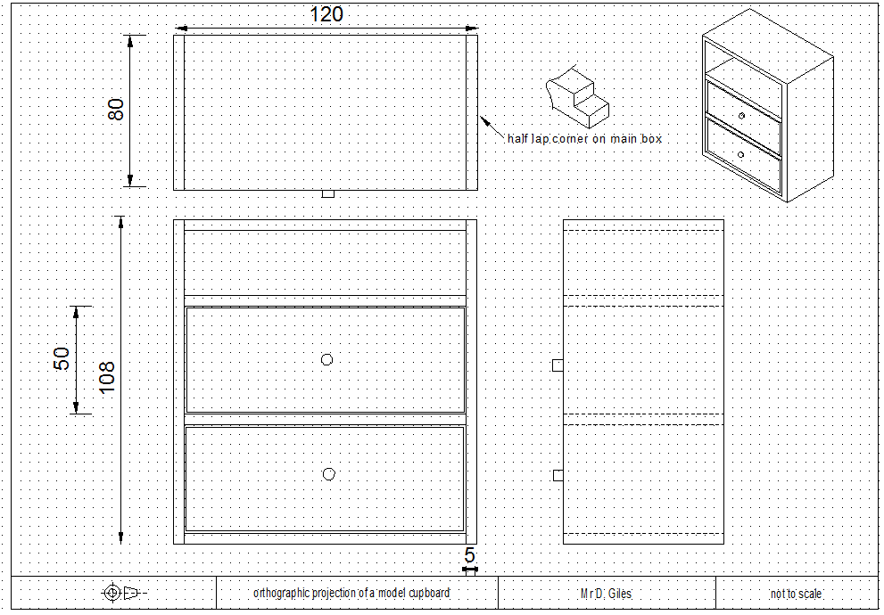
Q8
What is the overall depth of the product?

Slide 16
Q9
How thick is the wood being used?

Slide 17
Q10
What style is the 3D drawing presented in?

Slide 18
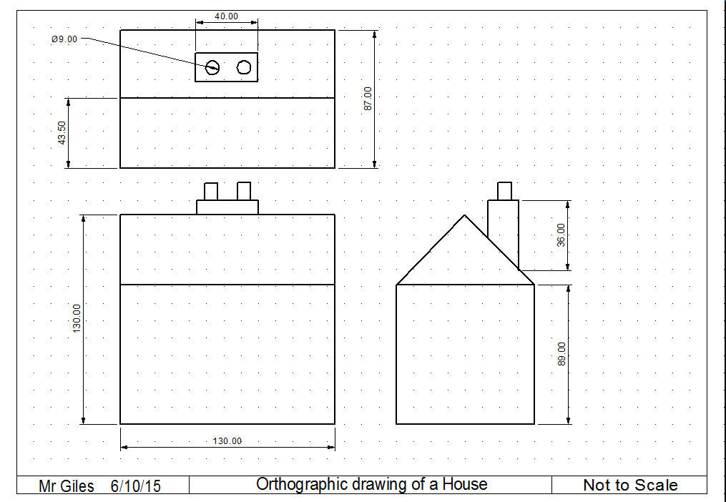
Q11
What is this type of drawing called?

Slide 19
Q12
What type/category of plastic does this diagram represent?
Heat
Harden
Soften
Cool

Slide 20
Q13
What type of plastics can’t be reheated and reshaped once they have been formed?

Slide 21
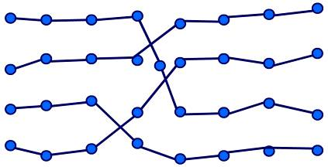
Q14
This is the molecular structure of a type/category of plastic-
which one is it?

Slide 22
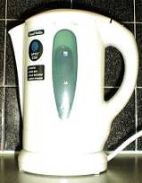
Q15
What type of plastic would be best to use for this product?

Slide 23
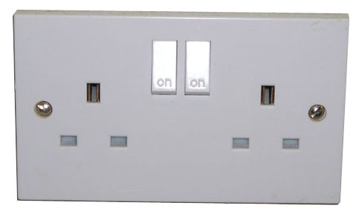
Q16
What type of plastic would be best to use for this product?

Slide 24
Q17
Epoxy resin falls into what category of plastic?

Slide 25
Q18
What do the following acronyms stand for (clue: it is the full name of a type of plastic)?
PET
HDPE

Slide 26
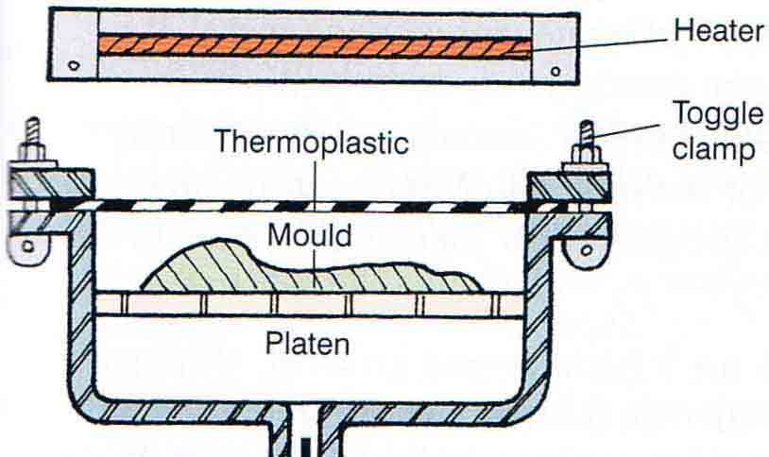
Q19
What plastics process does part of this diagram show?

Slide 27
Q20
What plastics process is described below?
Polymer Pellets are placed inside the mould
The mould is rotated in two directions, being heated at the same time
Melted polymer coats the inside of the mould
Mould is cooled, polymer sets
Object removed

Slide 28
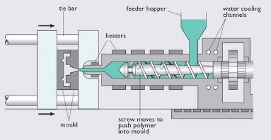
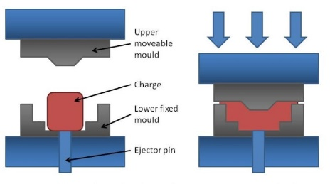
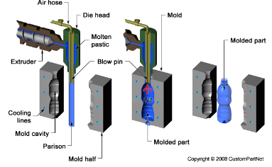
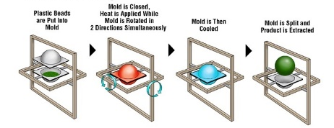
Q21 – bonus question
A
B
Name all these process’ below correctly for 5 extra marks?
D
C

Slide 29
Marking
Don’t cheat
Be honest
By the end of the course you should be able to answer all of these questions with ease.

Slide 30
Q1
Ferrous
non-ferrous
Alloy
Name the 3 main classifications of metals

Slide 31
Q2
If a metal is described as having good elasticity what does this mean?
Can alter and change its shape (stretch/bend ect)
And return to its original shape

Slide 32
Q3
If a metal is a good conductor what does this mean that it is good at doing?
Allows electricity/heat to pass through

Slide 33
Q4
Where does metal come from?
From the ground
In the form of ‘Iron Ore’

Slide 34
Q5
True or False
Copper is a non ferrous alloy?
Zinc is an alloy?
Aluminiam is spelt correctly?
True
False
False

Slide 35
Q6 - Guess me….
I am strong…
I am brittle…
I am ductile…
I am very lightweight…
I am silver….
Titanium
Copper
I am malleable…
I am tough….
I am corrosion resistant…
I am easy to join…
I am a good conductor…
I am used in pipes…..

Slide 36
Q7
What does CAD stand for?
Computer aided design

Slide 37
Q8
What is the overall depth of the product?
80

Slide 38
Q9
How thick is the wood being used?
5

Slide 39
Q10
What style is the 3D drawing presented in?
Isometric

Slide 40
Q11
What is this type of drawing called?
Orthographic

Slide 41
Q12
Thermoplastic
What type/category of plastic does this diagram represent?
Heat
Harden
Soften
Cool

Slide 42
Q13
Thermosetting plastic
What type of plastics can’t be reheated and reshaped once they have been formed?

Slide 43
Q14
This is the molecular structure of a type/category of plastic- which one is it?
Thermoplastic

Slide 44
Q15
ABS
What type of plastic would be best to use for this product?

Slide 45
Q16
What type of plastic would be best to use for this product?
Urea Formaldehyde

Slide 46
Q17
Thermosetting plastic
Epoxy resin falls into what category of plastic?

Slide 47
Q18
What do the following acronyms stand for
(clue: it is the full name of a type of plastic)?
PET
HDPE
polyethylene terephthalate
High density polyethylene

Slide 48
Q19
What plastics process does part of this diagram show?
Vacuum forming

Slide 49
Q20
Polymer Pellets are placed inside the mould
The mould is rotated in two directions, being heated at the same time
Melted polymer coats the inside of the mould
Mould is cooled, polymer sets
Object removed
What plastics process is described below?
Rotation moulding

Slide 50
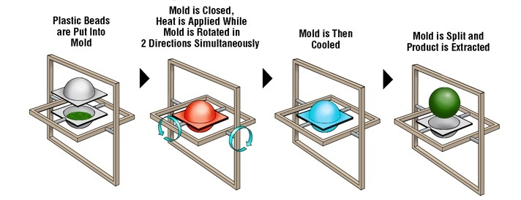
Q21 – bonus question
Name all of these process’ below correctly for 5 extra marks?
A
B
Compression moulding
Injection moulding
C
D
Rotational moulding
Blow moulding

Slide 51
Quiz has a maximum of 33 MARKS
How did you score?

Slide 52
An interest in Engineering is essential in taking part in this course.
There are many more documentaries to access but these are a good starting point for any student.
https://www.youtube.com/watch?v=8NXLKRW1IEU The making of a mega wind turbine
https://www.youtube.com/watch?v=dQf_vE7tOlw Earthquake proof bridge
Please take some time to access and watch some of the many documentaries on engineering. You should find at least 1 which interests you
Taking an active interest will help you to understand engineering concepts and apply real world thinking to the learning which takes place in the lessons.
https://www.youtube.com/results?search_query=big+bigger+biggest Big bigger biggest series (choose one, there are loads)
https://www.youtube.com/watch?v=ahgrNHuURKs Inside the tesla factory
https://www.channel4.com/programmes/how-to-build/episode-guide How to build series

Slide 53
Your commitment to the course will also be assessed through the bridging units: So don’t forget to show your potential through these tasks
Engineering bridging units:

Slide 54
I will leave you with this.
The poor little pog is about to drown!
Which way should he move the lever on the first cog to pull the plug out?

Slide 55
If you have any further questions please contact Mr Gregory
lgregory@nationalce-ac.org.uk

