Slide 1
Skills for Health and Social care
One of the most important skills you learn is that of communication.
Either brainstorm or use a wordle to record all the different ways of communicating.
http://www.wordle.net/create

Slide 2
Cambridge Technical Level 3
Health and Social Care

Slide 3
The course
Unit | How its assessed
Building positive relationships in health and social care | Portfolio
Equality, diversity and rights in health and social care | Exam
Health, safety and security in health and social care | Exam
Anatomy and physiology for health and social care | Exam
Nutrition for health | Portfolio
Sexual health and relationships | Portfolio

Slide 4
Tell me a story
https://www.youtube.com/watch?v=1Ze_ISTfqqg
What could children learn from the book?
what skills would you use when reading a book?
What could make it more meaningful?
Notes:
Read story – whats in it for me?

Slide 5
Activity one
Use the attached images to complete this task. Choose one image and describe how the other person could draw it without showing them.
You can do this activity with a member of your family or in a teams chat with a friend. Alternatively try writing a set of instructions to enable someone else to draw the picture.
What does this tell you about communication?

Slide 6
Activity 2
Sit at a table facing the front you need 2 pieces of plain paper
Close your eyes
Follow the instructions I give you.
Now I will repeat the task same again
What does this tell you about communication?

Slide 7
Paper dolls
Write down what you can remember about the story.
What does this tell you about effective communication and how we remember things?

Slide 8
Plenary
What have you learnt about communication?
How could this help you when working in health and social care
Try to give an example of when you would use at least one of the skills we have focused on today
Make your own set of paper dolls and record key facts about communication you have learnt today on each one.

Slide 9
Please send me any work or questions to:
smckenna@holgate-ac.org.uk

Slide 10
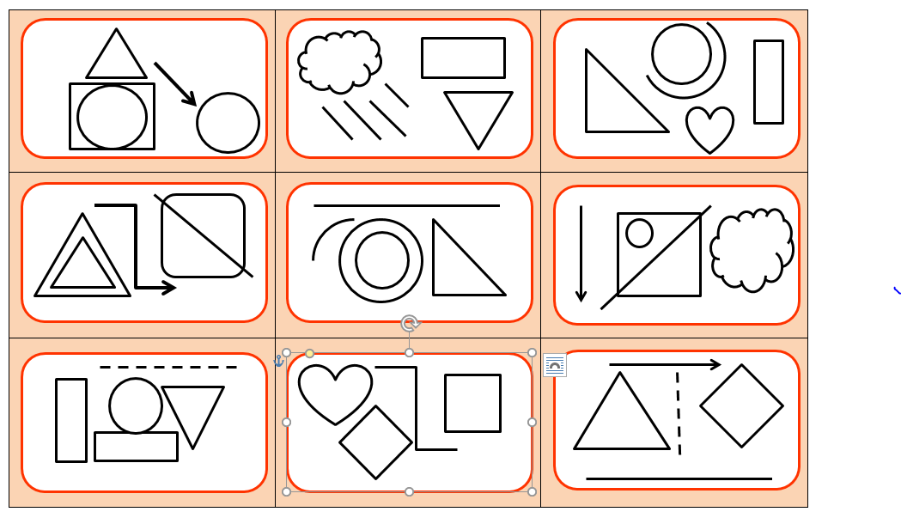
Choose one of these images to describe for activity 1

