Slide 1
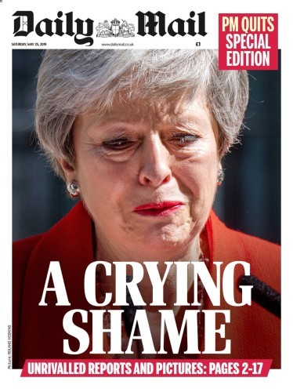
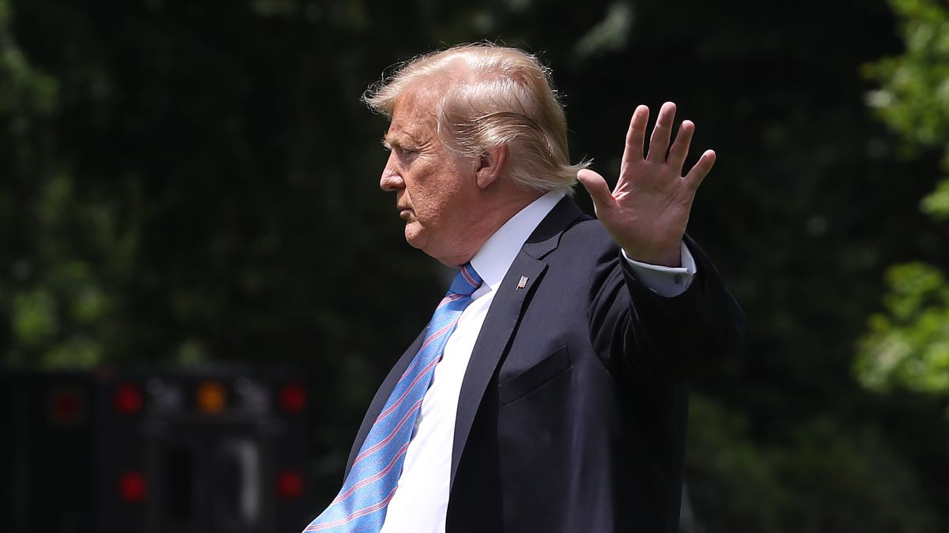
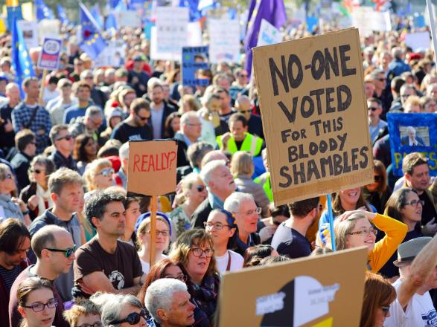
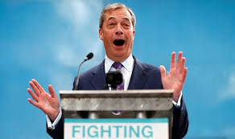
What a time to be a politics student!

Slide 2
The purpose of this session
Is to give a flavour of some of the key things we will be looking at over the next two years
Plenty of discussion over the next 40 minutes
Thoughts, ideas, opinions welcome

Slide 3
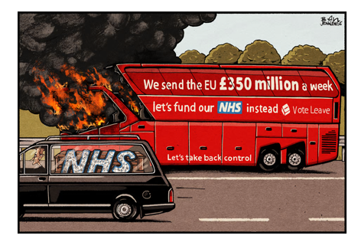
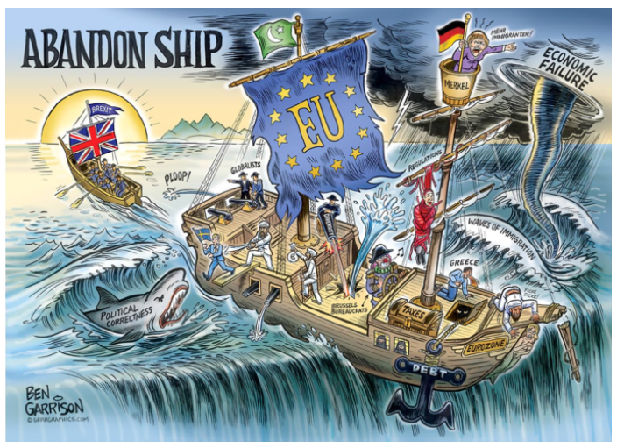
Thoughts on each to begin? What recent event does this relate to – what do you know about this?
Skill 1 : Understanding the political climate that we live in

Slide 4
Politics is ultimately about differing opinions about how the nation should be best run
If we were together I would be asking you to consider carefully what you feel about each of theses key issues. Perhaps instead as you are at home you could jot your thoughts down and as you do this think about your argument – how would you convince people that your argument was valid?
Skill 2 : Judgement, political opinion and justification

Slide 5
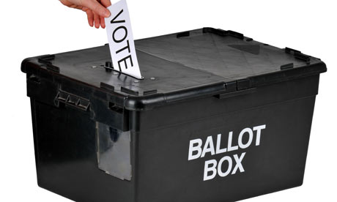
1. How old do you think people should be before they can vote, 16 or 18?
Scotland has this in place for referendums…..over 1 million young people turned out in 2014
Argument against this is one of influence – are 16 year olds independent enough to vote on their own? Or would they vote how someone tells them to?

Slide 6
2. Would you bring back the death penalty?
Some argue inhumane, unfair and not appropriate.
The murder rate in England and Wales rose by 11% to 573 homicides in 2015.

Slide 7
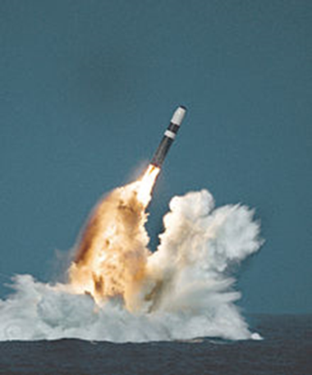
3. Would you keep our Nuclear Weapons?
Replacing Trident estimated cost £31b
8 other countries have nuclear weapons – what happens if we are attacked by one of these and we don’t have any?

Slide 8
Why is democracy important? Discuss in your groups
Skill 3 : recall of particular key terms
Notes:
https://www.youtube.com/watch?v=ucTLKmvCyUI

Slide 9
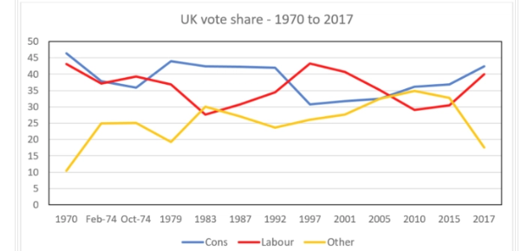
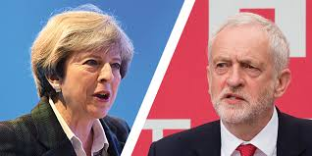
Differences between political parties – times change quickly. These were in charge this time last year: who is in charge of each party now? How did they get there?

Slide 10
Decision making
The next slide helps you consider what politicians promise us and why.
Put yourself in the shoes of the Chancellor of the Exchequer (if you don’t know who this is or what they do just google them).
You have £100m to spend – how are you going to do it? There is no wrong answer here.
Can you justify your decisions?

Slide 11
How would you spend a fictitious budget of £100m? Be prepared to justify your response
Area | reasoning
Health | Free healthcare available to all costs a huge amount. Think of all the costs and wages. Spend less than £40m and waiting lists go up and people die.
Education | Free education from 3-16. Think of the costs of running a school (£6.5m for us alone!) and all the wages. Spend less than £30m and children suffer. Also your economy suffers as less people going through higher education etc
Defence | The army, navy, air force, secret service. Provide jobs and protection. Spend less than £20m we could come under attack.
Transport | Motorways, airports, train tracks. Spend less than £20m Britain grinds to a halt, people make less £ and companies suffer. Unemployment!
Pensions | People get £ after they retire. Spend less than £30m and the elderly suffer….who also are the group that vote the most. The UK population is ageing – around 18.2% of the UK population were aged 65 years or over at mid-2017, compared with 15.9% in 2007; this is projected to grow to 20.7% by 2027.
The police | Protect our streets. Simple. Keep crime down. Spend less than £30m and crime goes up. More people have houses burgled, more violent crime.
Skill 4 : analysing policy proposals by the main parties

Slide 12
How do people participate in politics? Can you make a list?
?
?
?
Participation

Slide 13
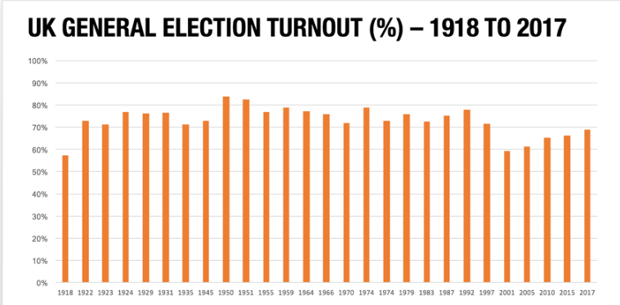
Do we have a problem? What conclusions can you draw from this data? If you had to add the data for 2019 what would that show?
Skill 5 : analysing why people vote the way they do

Slide 14
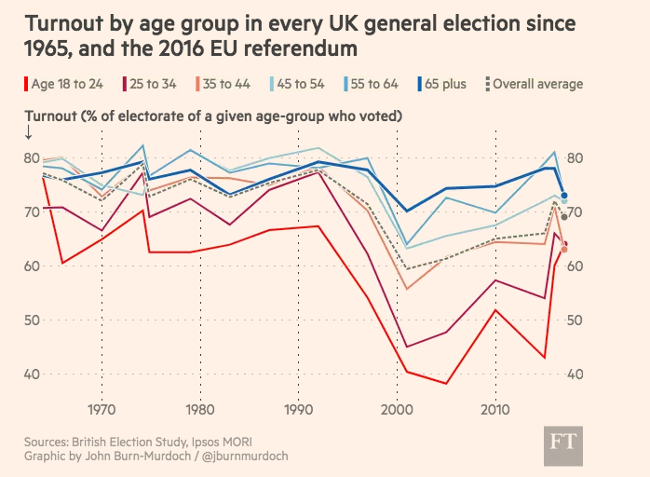
What does this show? Are all ages equal in terms of turnout?

Slide 15
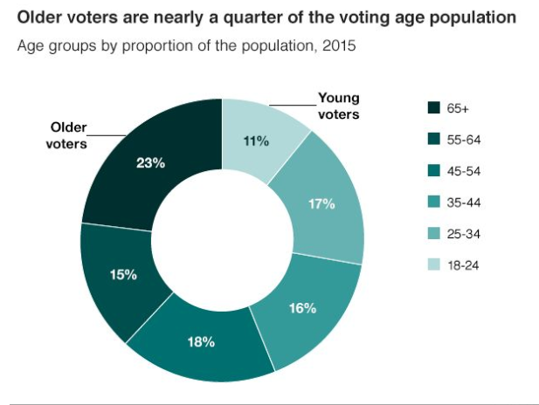
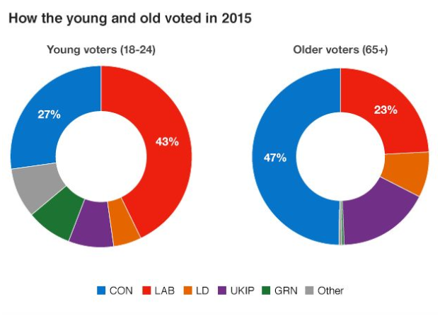

Slide 16
Looking back at the last 3 slides
What would you say that the most pressing concerns are in terms of turnout?

Slide 17
The message of this cartoon is:

Slide 18
Politics at AS Level
Democracy
Voting behaviour
Parties
Elections
Pressure groups
Parliament
The Prime Minister
Lots of others!!

