Slide 1

So what is A-Level Religious Studies: Christianity, philosophy and ethics?

Slide 2

Expectations
To be punctual
To meet deadlines
To keep on top of reading
To try your best

Slide 3
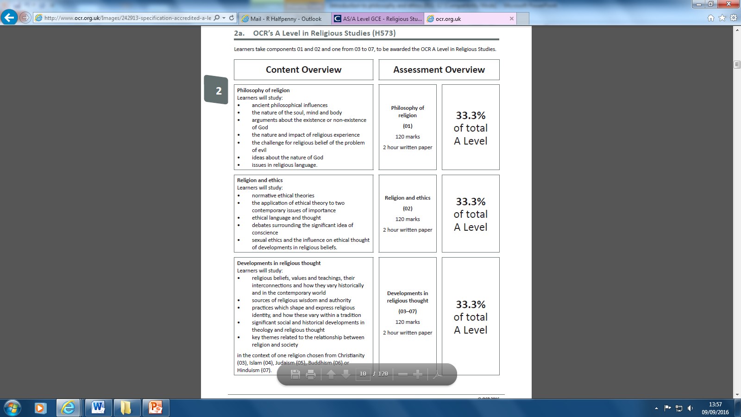
Year 12

Slide 4
Year 12

Slide 5
Year 12

Slide 6
The exam…
You are studying for the Advanced level (A-level) qualification in Religious Studies: Philosophy and ethics H573
You will cover the philosophy part of the course with Mrs Halfpenny
The ethics part of the course with Mr Wildey
Developments in Christian thought-taught by both Mrs Halfpenny and Mr Wildey

Slide 7
Textbooks
It is in your best interest to get a textbook for use at home.
You will get guided reading every week from at least philosophy or ethics and the questions will be based on one of the main texts we use.

Slide 8
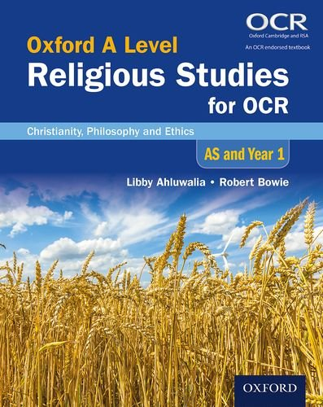
Textbooks
Religious Studies for OCR: Christianity, Philosophy and Ethics AS and Year 1
Libby Ahluwalia & Robert Bowie
ISBN: 978-0-19-839285-9
Amazon £25.50

Slide 9
Bridging tasks
Complete over the summer
Bring evidence of what you have done in September

Slide 10
WHAT IS ETHICS?

Slide 11
Objectives:
1. To define ethics.
2. To encourage students to consider how they come to moral decisions.
3. To introduce three ethical theories and consider how each would approach moral issues.

Slide 12
LOOK AT THE ‘MAKING MORAL DECISIONS’ SHEET.
Consider each of the moral dilemmas outlined on the sheet.
What would you do in each situation?
How did you reach your conclusions?

Slide 13
WHAT IS ETHICS?
The term ‘ethics’ comes from the Greek word ethikos, meaning ‘character’.
It can be translated as ‘custom’ and refers to the customary way people act in society.
Ethics is a branch of philosophy concerned with morality.
Today modern ethics is concerned with 4 fundamental questions:

Slide 14

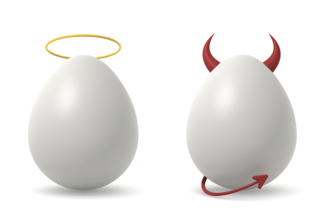

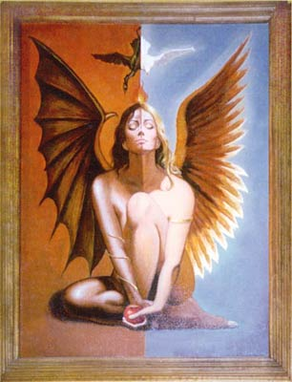
1. Do good/bad and right/wrong exist?

Slide 15



2. What is meant by the moral terms good/bad and right/wrong?

Slide 16
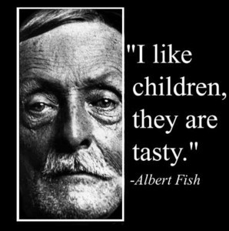

3. Are there good/bad and right/wrong actions?

Slide 17


4. What should the individual or society do in order to be morally good or right?

Slide 18
From the earliest times, philosophers have attempted to answer these questions.
They have put forward a variety of theories explaining how we should come to moral decisions.
Here are 4 of them.

Slide 19
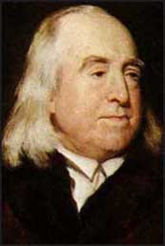
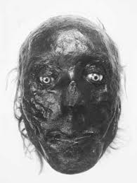
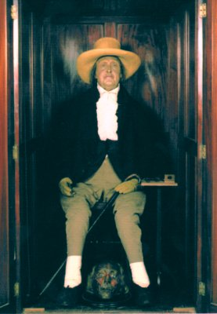
UTILITARIAN ETHICS
A THEORY PUT FORWARD BY JEREMY BENTHAM (His mummified body is still on show at King’s College, London!)

Slide 20
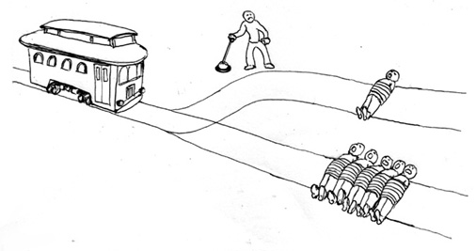
When you are making an ethical decision you must:
a. decide what action would bring the greatest happiness to the greatest number of people;
b. or what action would bring the least amount of unhappiness to the most people.
c. not take personal
relationships
into account.

Slide 21
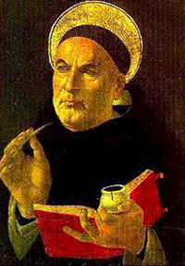
NATURAL LAW ETHICS
A THEORY PUT FORWARD BY THOMAS AQUINAS.

Slide 22
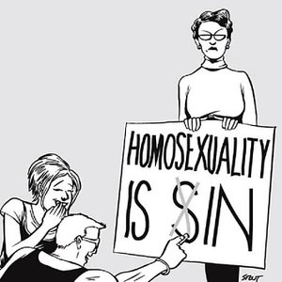
When you make an ethical decision you must:
use your reason;
follow the first precept (rule) which is to preserve life;
as far as possible keep to what is natural, i.e. part of the natural scheme of things.

Slide 23
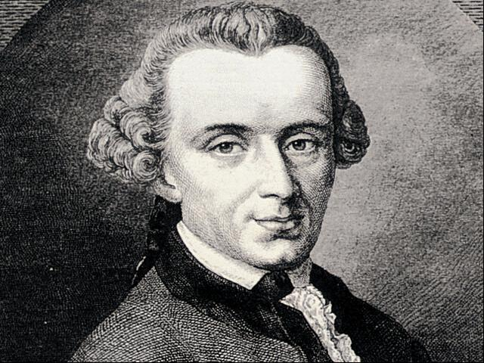
KANT’S ETHICS
A THEORY PUT FORWARD BY IMMANUEL KANT.

Slide 24
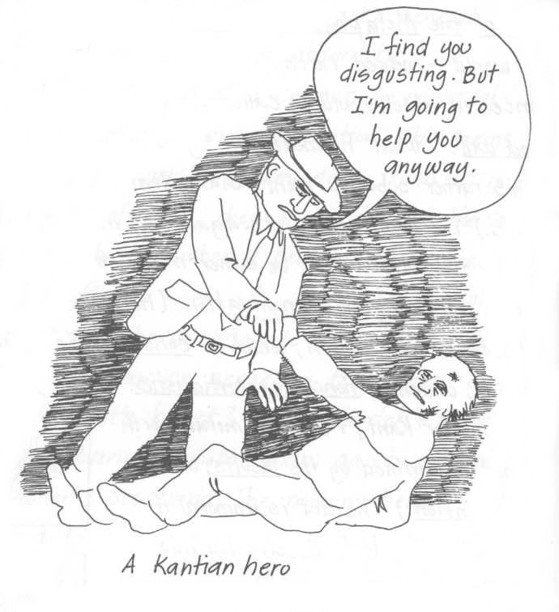
When you make an ethical decision, you must:
act only out of duty, not for any ulterior motive;
only do something that you would be happy for everyone else to do in the same situation.

Slide 25
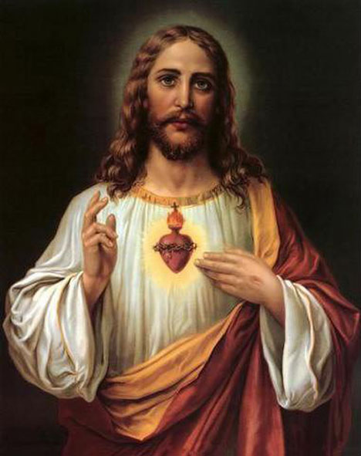
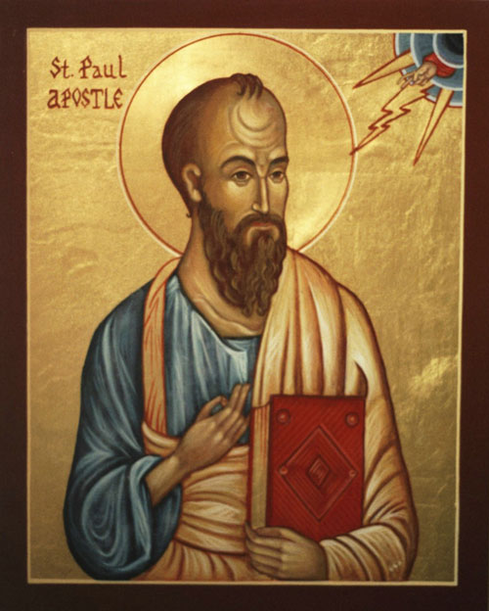
CHRISTIAN ETHICS
A THEORY DERIVED FROM THE BIBLE, ESPECIALLY THE TEACHINGS OF JESUS AND SAINT PAUL.

Slide 26
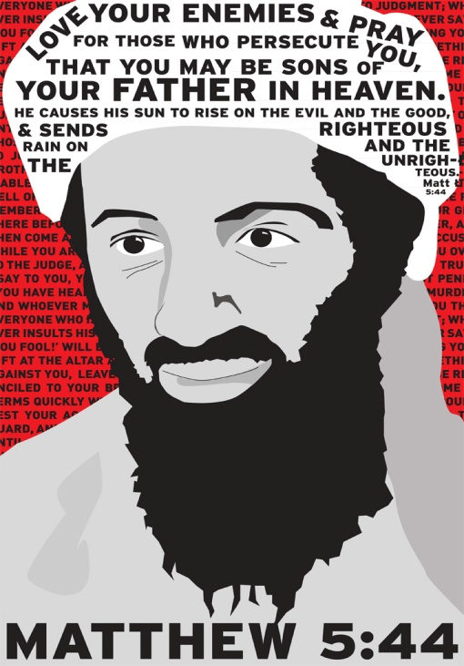
When you make an ethical decision you must:
Consider Jesus’ main teachings –
- love God
- love your neighbour
- love your enemy
- do not judge others
- treat others as you would like
to be treated.

Slide 27
NOW RETURN TO THE ‘MAKING ETHICAL DECISIONS’ SHEET.
How would a utilitarian, Natural Law theorist, a Kantian theorist and a Christian decide how to act in each of the dilemmas?
Which ethical theory do you most identify with?

