Slide 1
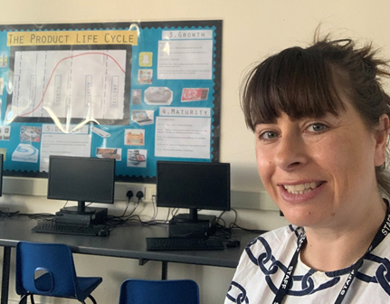
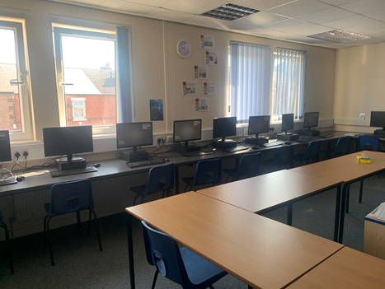
Welcome to Business at HSFC
Hello and Welcome!
Really sorry I cant see you all in person today but I would like to try and give you an idea of what my Business lessons are like.
I have been teaching Business for over 15 years and I LOVE IT! So I hope you will enjoy this subject also.
My email is on the last slide so any questions make sure to get in touch
I hope to see you in September
Mrs Hague

Slide 4
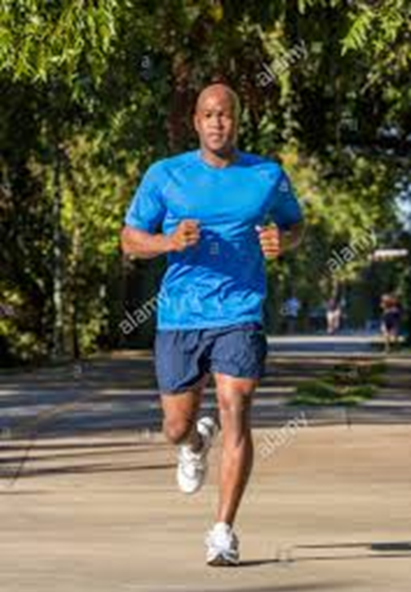
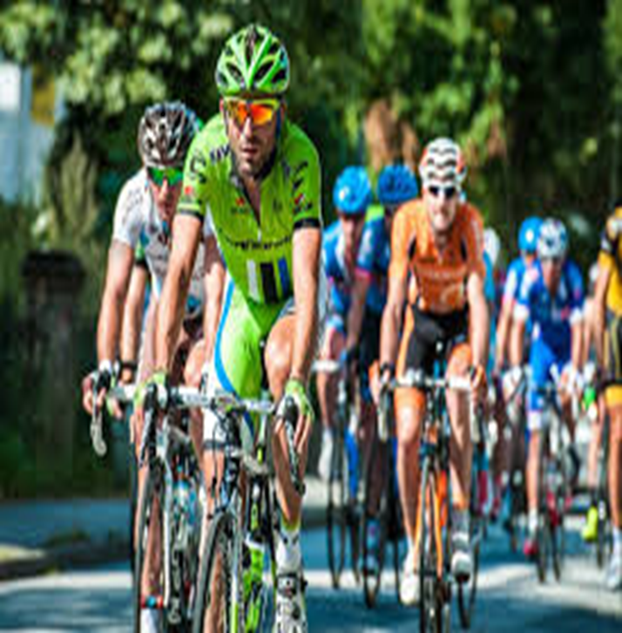
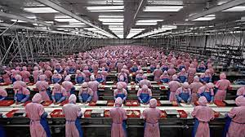
Cambridge National Level 3 Business
Year 12
Unit 1 The Business Environment (exam in January)
Unit 4 Customers and Communication
Year 13
Unit 2 Working in Business (exam in January)
Unit 16 Principles of Project Management
Unit 17 Responsible Business Practice

Slide 5
Foxconn
Foxconn, also known as Hon Hai Precision Industry Co, is the world's largest contract maker of electronics, with factories across mainland China. It's best known for making iPhones and other Apple devices but its long list of customers includes Sony Corp, Dell and BlackBerry Ltd.

Slide 6
Huge production plants

Slide 7
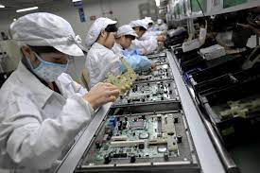
Over 800’000 employees around the world

Slide 8
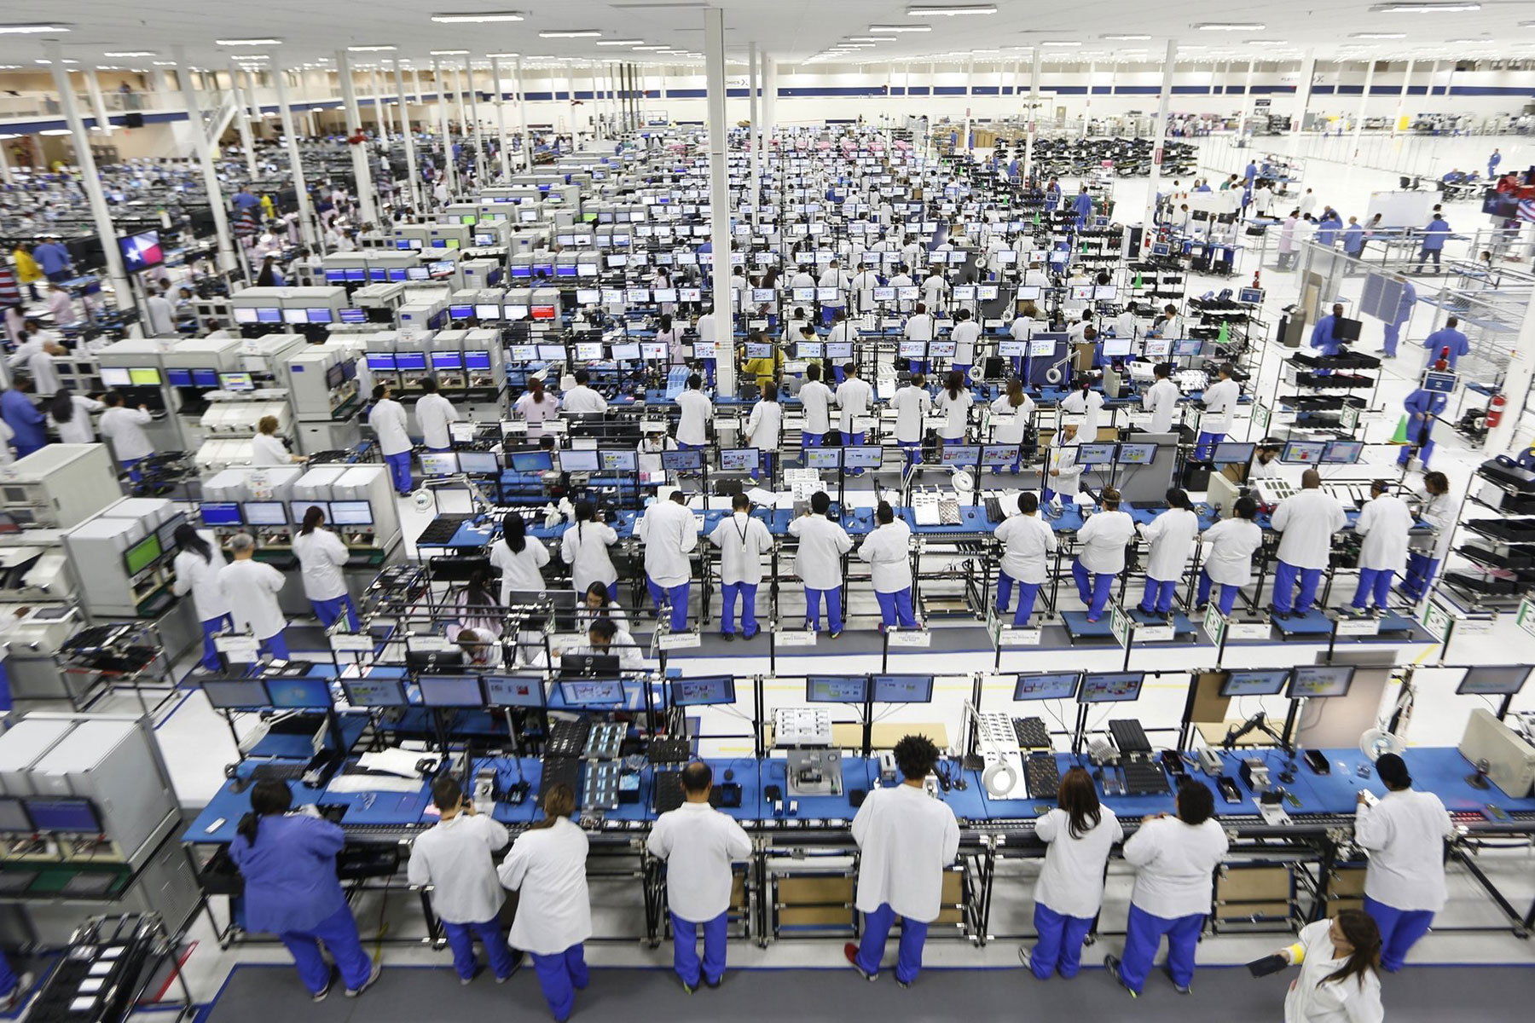
Over 800’000 employees around the world

Slide 9
Have a look on BBC news and research Foxconn (5 mins)
What are some of the negative things you find out about this business?

Slide 10
Foxconn
A five-minute CNN video on Foxconn, including an interview with a Foxconn worker about conditions in its factory.
https://www.youtube.com/watch?v=0VOl0WamNSY
Working conditions
Poor pay
Riots and strikes

Slide 11
If you have any questions about this task or the course in general please contact:
Mrs Hague on the email below
ahague@Holgate-ac.org.uk

