Slide 1
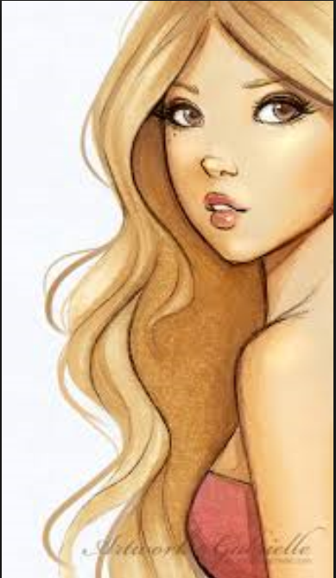
Girl Found Dead in abandoned cottage
English Literature AS Level
A young girl, named locally as Porphyria, has been found dead in an abandoned cottage near a lake. The girl, pictured, did not live at the cottage, and so detectives are treating the death as suspicious.
Can you think of a more impressive newspaper headline based on the information?

Slide 2
Detective Time
English Literature AS Level
You need to solve the murder of Porphyria.
In each envelope you have:
- Possible murder weapons - Possible suspects - Clues to what happened
It is your job to sort through the evidence and decide who killed Porphyria, how they killed her and why they killed her

Slide 3
English Literature AS Level
And the verdict is…?

Slide 4
Porphyria's Lover
English Literature AS Level
Quick Questions for discussion:
can you love somebody too much?
is murder ever okay?
can love make you crazy?

Slide 5
Porphyria’s Lover – The Poem
English Literature AS Level
Written by Robert Browning in 1836
It is a ‘dramatic monologue’
Focuses on a mad narrator and his strong love for Porphyria
The narrator strangles Porphyria with her hair
Where have we seen this before?

Slide 6
English Literature AS Level
The speaker in the poem lives in a cottage in the countryside. His lover, a young woman named Porphyria, comes in out of a storm and proceeds to make a fire and bring cheer to the cottage. She embraces the speaker, offering him her bare shoulder.
He does not speak to her, instead, he listens as she tells him how she is going against her family and friends to be with him. He realises that she “worships” him at this instant. Realising that she will eventually miss her family and leave him, and wanting to preserve the moment, he wraps her hair around her neck and strangles her.
He then toys with her corpse, opening the eyes and propping the body up against his side. He sits with her body this way the entire night, remarking that God has not yet moved to punish him.

Slide 7
English Literature AS Level
A huge part of advanced level study is independent learning.
You MUST be prepared to do a lot of the work by yourself.
In English, your teacher will not tell you everything you need to know about a poem or a novel; you are expected to read and research them for yourself and use your lessons to analyse, explore and evaluate.

Slide 9
Read the poem… Did Porphyria’s lover actually love her at all?
English Literature AS Level

Slide 10
Around the room are several images which potentially depict Porphyria. Select the one that you feel is the most accurate. Be prepared to justify why you have chosen that image. Try to link your thoughts to specific ideas/quotes from the poem.
English Literature AS Level

Slide 11
In pairs, choose 1 of these questions here. Jot down some thoughts on the paper that’s on your tables. How does Browning convey a sinister tone in the poem? How is the weather effective in foreshadowing Porphyria’s death? Does Porphyria seem weak and fragile to you? Justify your thoughts.
English Literature AS Level

Slide 12
Email: chunt@nationalacademy.org.uk
English Literature AS Level

