Slide 1
HSFC Induction
Your questions answered!

Slide 2
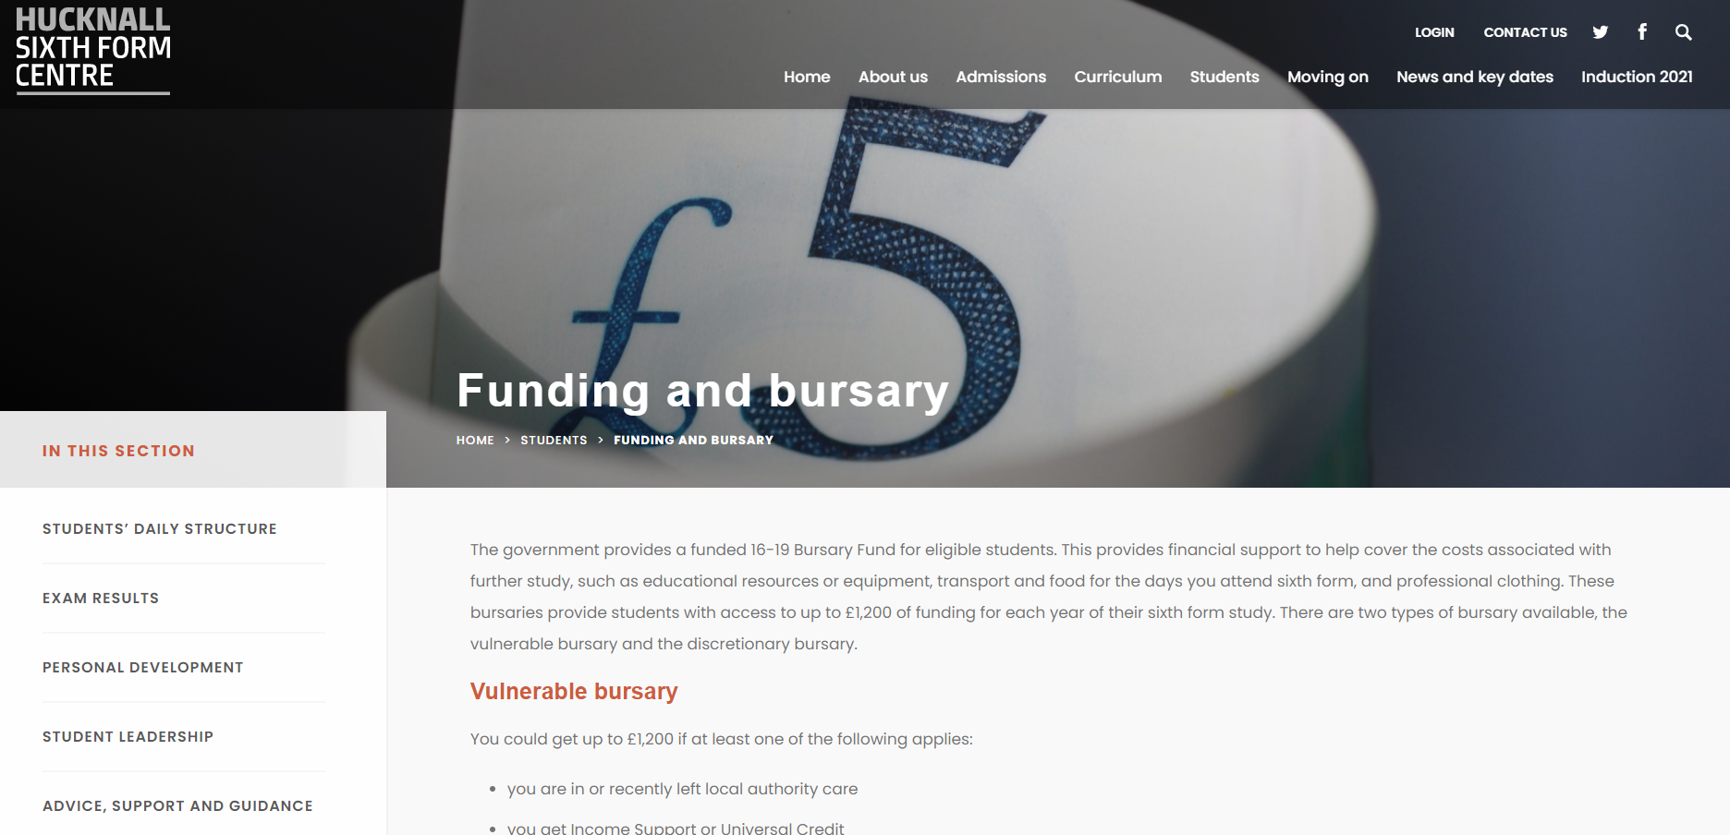
"How do I apply for a bursary and what does it entail?"
Forms and guidance available on our website.
Updated in the summer for next years applications.
We will give more guidance in September.

Slide 3
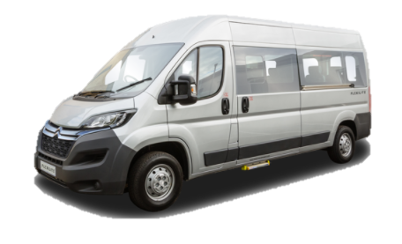
“Which lessons take place away from HSFC?”
Drama
Engineering
Music
Art
DT
Sport/PE
Some single periods may take place at National or Holgate if the teacher does not have time to travel to HSFC – but these are rare!
Our mini bus will take you – free of charge!

Slide 4
What do we do if we can't make the enrolment day?
National Students: Email K Wall – kwall@nationalacademy.org.uk
Holgate/QEA students: Email S Hall – shall@diverseacademies.org.uk
External: 0115 9681657

Slide 5
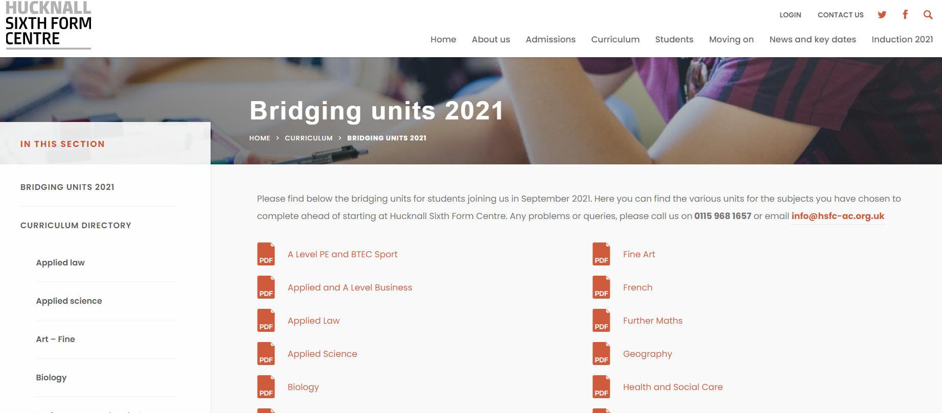
“How do you access the bridging units?”
https://www.hsfc-ac.org.uk/curriculum/bridging-units-2021/

Slide 6
“If there is a timetable clash- at what point and with who do I discuss it?"
You should have already been notified of a clash if it occurred in your initial application.
All applicants have been sent the option blocks.
If you want to change an option you will need to discuss this at enrolment.

Slide 7
“How many subjects do we choose?”
Students normally take 4 subjects, dropping to 3 in Y13.
Please speak to staff at enrolment if you have any queries or concerns about this.

Slide 8
“When will we get timetables?”
You will get timetables when you start in September.
They are created once you confirm your enrolment in summer.

